Slide 1

Application Programming Interface
Mario Luevano

Slide 2
Uses
APIs allow communication between different apps and systems such as website or app. (Weather App on iOS)
Adds value to your application such as Postal Service API, Checkout APIs for commerce by extending functionality
Hide Complexity and allows for control of what data is sent and received

Slide 3
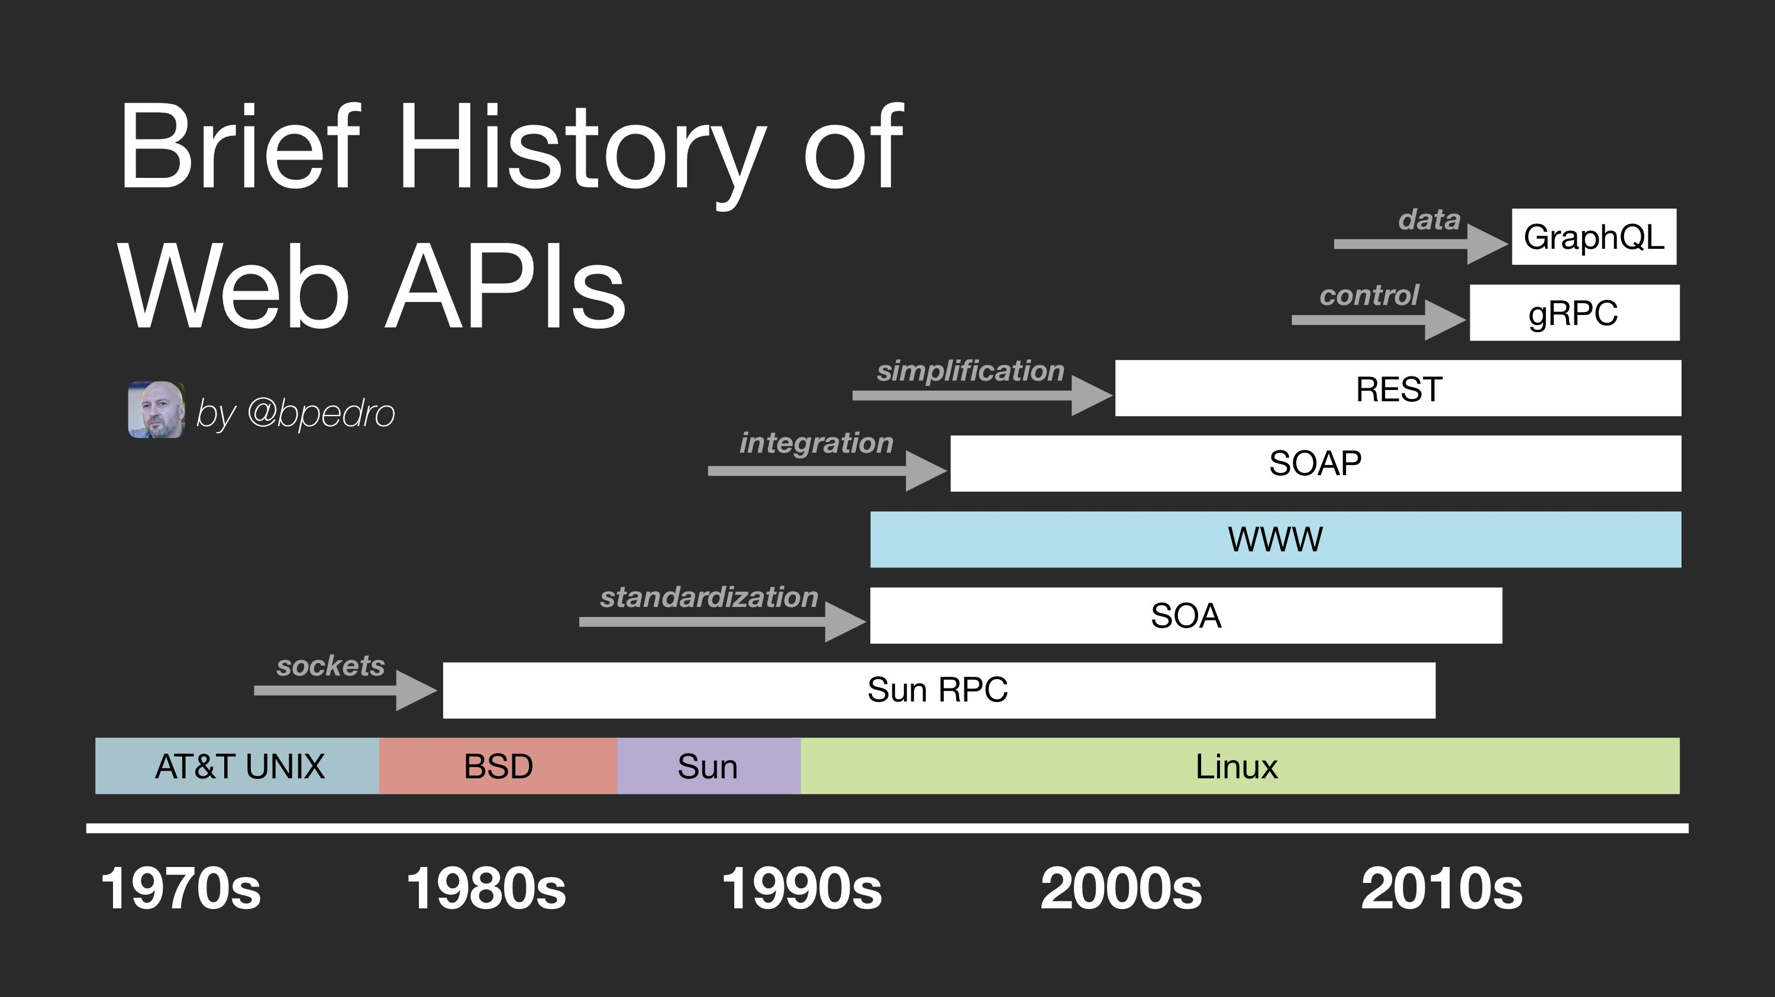
History of API

Slide 4
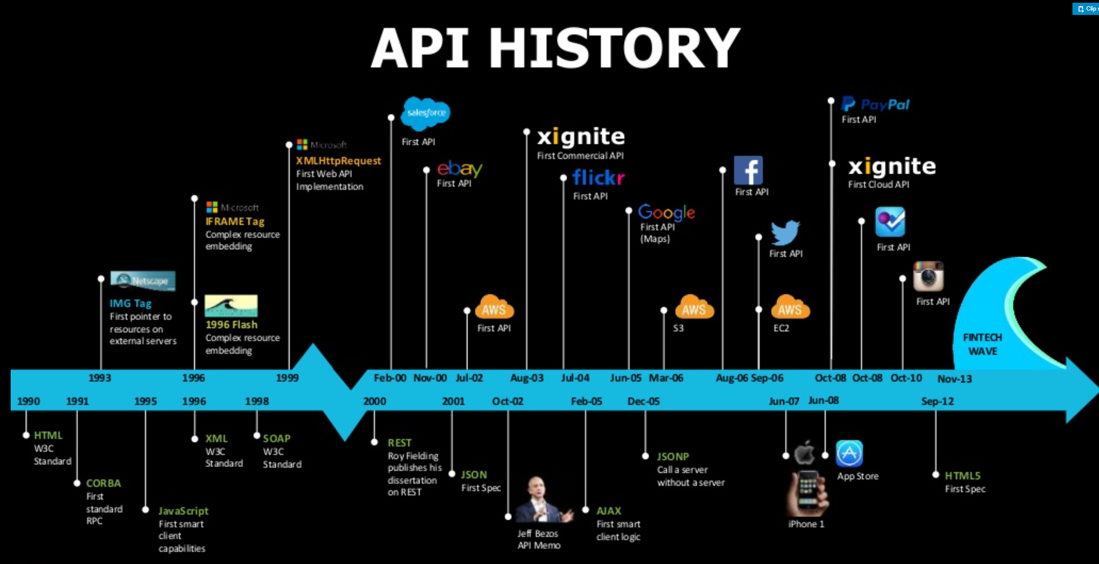
Emergence of APIs

Slide 5
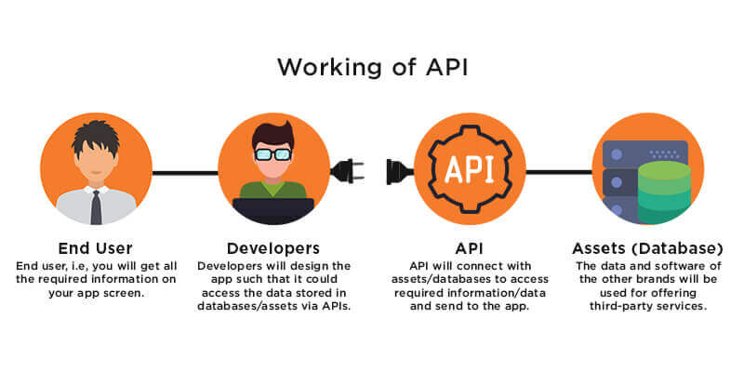
Designing an API

Slide 6


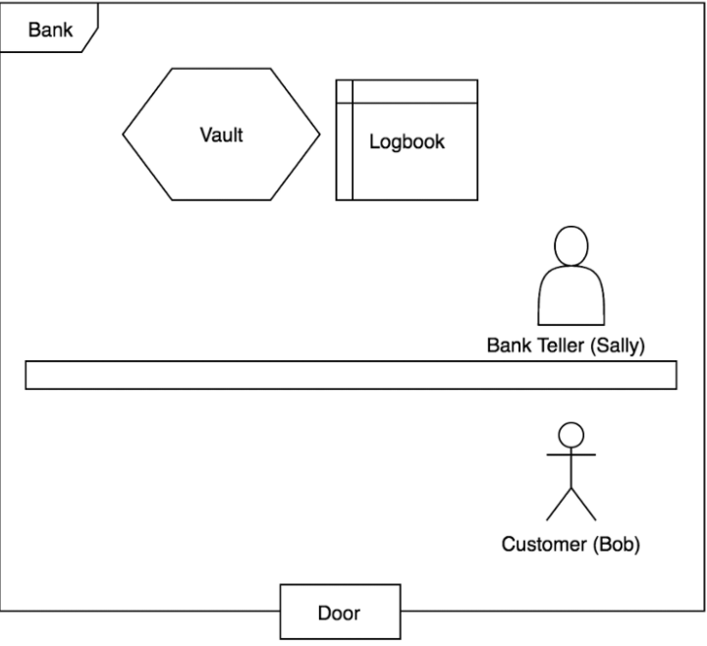
Bank Example
Vault and Logbook are not accessible by the customer
Customer Queues Up and asks for access to his account after presenting his credentials
Bank Teller acts as API
  Handles transaction
Customer leaves with his money without interacting with the bank system

Slide 7
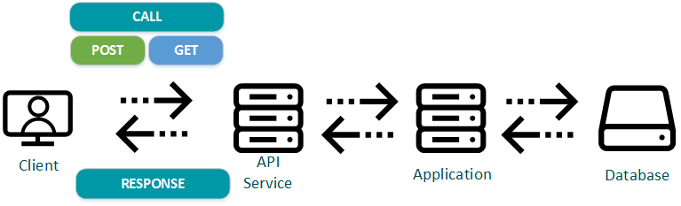
How it works
API Key: An authorized code given into the request is called an API Key
Endpoint: When an API interacts with another system, one end of the communication channel is termed as Endpoint.
GET: HTTP method for obtaining resources (response) and reads
  Parameters in URL
  Used for fetching documents or data
POST: HTTP method for building resources and creates resources
  Parameters in body
  Used to update data
FETCH: Simple interface for fetching resources

Slide 8
MAIN TYPES of Web APIs
Open APIs: Also known as Public API, there are no restrictions to access these types of APIs because they are publicly available. (Google Maps)
Partner APIs: A developer needs specific rights or licenses in order to access this type of API because they are not available to the public.
Internal APIs: Also known as Private APIs, only internal systems expose this type of API. These are usually designed for internal use within a company. The company uses this type of API among the different internal teams to be able to improve its products and services. (data analysis such as sales)
Composite APIs: This type of API combines different data and service APIs. It is a sequence of tasks that run synchronously as a result of the execution, and not at the request of a task. Its main uses are to speed up the process of execution and improve the performance of the listeners in the web interfaces.

Slide 9
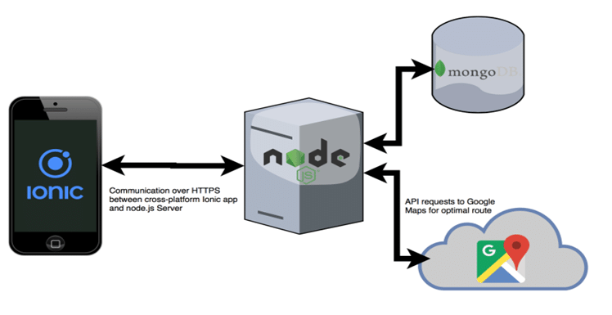
Public APis

Slide 10
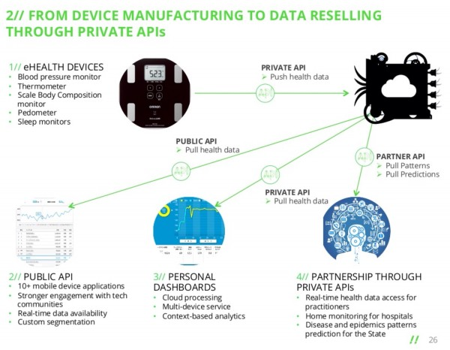
Private and Partnership APIs

Slide 11
API Protocols - SOAP
Simple Object Access Protocol
Similar to the REST API Protocol
Standardized the way application interact with network connections to manage services
Strict and Rigid standards
A lot of development has been done on it
Web Service
  Language Platform Transport Independent
  Distributed Enterprise Environments]
  Build-In Error Handling

Slide 12
API Protocols - REST
Representational State Transfer, A key part of modern web applications like Netflix and Amazon
  Stateless – stateless nature, Client-Server Architecture
  A client and should communicate with one another via HTTP using URIs, CRUD and JSON
Client-Server—The client and server should be independent of each other. The changes you make on the server shouldn’t affect the client and vice versa.
Cache—The client should have the ability to cache the responses as this improves the user experience by making them faster and more efficient.
A lot of programming uses REST APIs up to 70%!

Slide 13
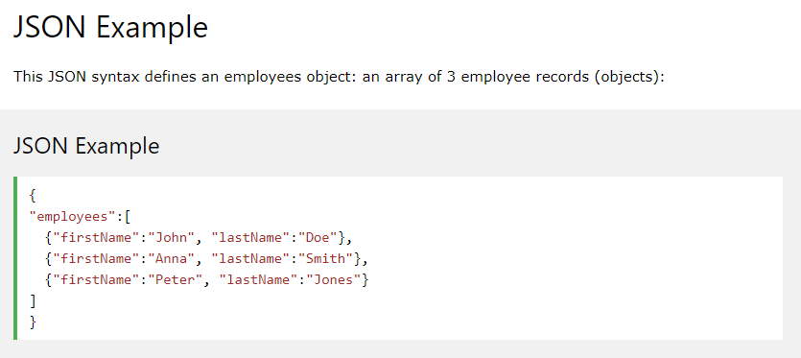
JSON
JSON stands for JavaScript Object Notation
JSON is a lightweight data interchange format
JSON is language independent *
JSON is "self-describing" and easy to understand

Slide 14
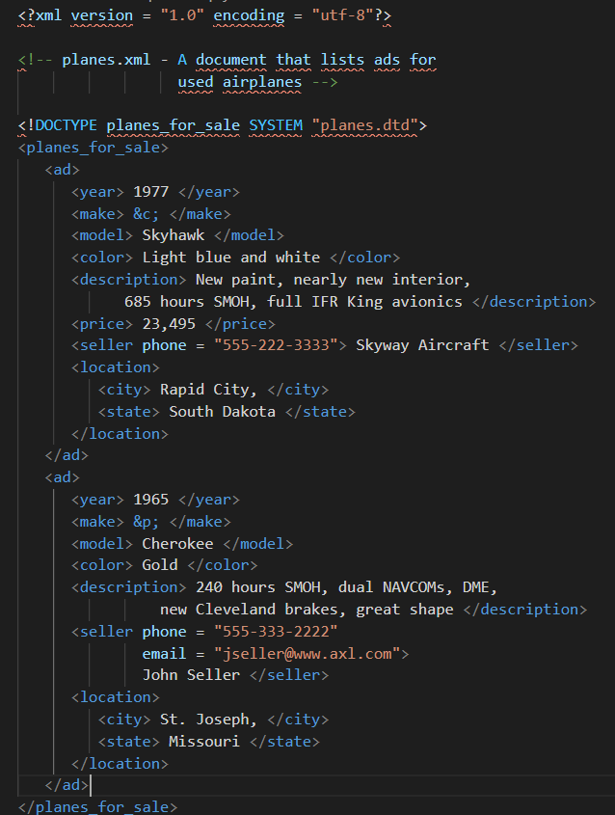
XML
Meta Data Support – One of the biggest advantages of XML. Metadata into tags that can be placed into attributes
Browsing Rendering – Highly readable by bowsers and organized. Useful in debugging problems.
Mixed Content Support – Communicate mixed content with the same payload

Slide 15
Examples
Pokemon API
Unofficial NBA API
Top 25 free APIS

